Slide 1
V93xx D version product upgrade instructions
Electric Power Measurement Division

Slide 2
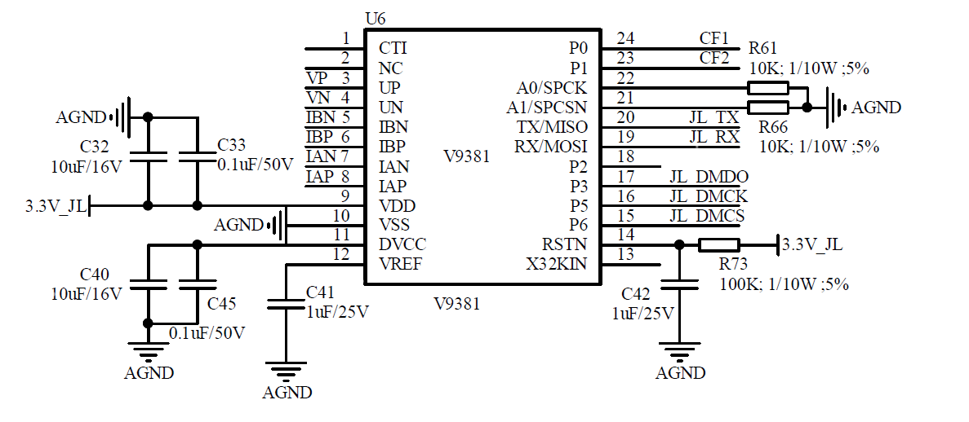
Peripheral circuit optimization
DVCC pins only need to be connected to a 0.1uF capacitor
Further reducing system costs, the PCB can maintain the original components without the need to remove capacitors, without affecting the original C-version chip solution used.

Slide 3
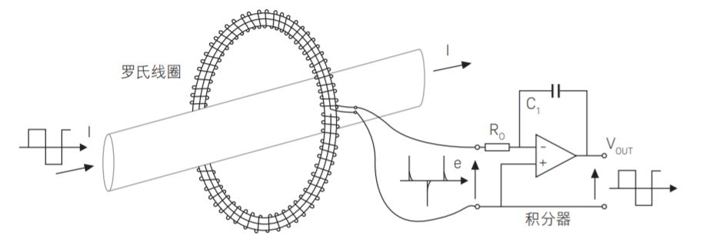
Added support for Rogowski coil
When the external sampling circuit adopts the Rogowski coil method,
It is necessary to integral processing the input current signal in order to truly restore the sampled current signal.
V93XX-D version adds digital integrator design through register DSP_ CTRL6 can select to enable the Rogowski coil function of channels A and B.
Rogowski coil
integrator

Slide 4
Optimization of fundamental wave function
Optimize the accuracy of fundamental wave error
Under 3rd and 5th harmonics, the error between fundamental active power and fundamental reactive power is ≤ 1 %.
Optimize the accuracy of frequency influence error
At frequencies ranging from 45 to 55Hz, the error between fundamental active power and fundamental reactive power is ≤ 1%.
Add fundamental wave separate calibration register
The fundamental wave supports separate calibration, making it convenient for users to further compensate for the fundamental wave.
Users can use FUND_ CALI_ ON (0x80, DSP_CTRL6, BIT25) is turned on. Use the 0x81~0x8e address registers to calibrate the fundamental wave.

Slide 5
Improved voltage sag and swell functions
Add voltage sag and swell to determine the time cycle setting
Can be accessed through DIP_ SWELL_ UNIT (0x8f, Bit [27:12] of DIP_SWELL_CTRL) for configuration.
Configuration range: 1-65536 half waves.
Default half cycle wave judgment
Add records of the maximum and minimum values of Swell and their response time
Read register DAT_ SWELL_ CNT/DAT_ DIP_ CNT obtains voltage sag/swell time records.
Read SWELL_ REG_ MAX_ CNT/DIP_ REG_ MIN_ CNT can obtain time records when the voltage sag/swell reaches its maximum value.
Read register SWELL_ REG_ MAX/DIP_ REG_ MIN can obtain records of the maximum/minimum values during the voltage sag/swell process.
Add sag and swell end interrupt and flag bits
The voltage sag and swell end interrupt can be output through the configured IO port.

Slide 6
Function extension
Add frequency, refresh cycle, configurable, and analog measurement mode
Frequency measurement adds an analog measurement method, which achieves fundamental frequency measurement through a voltage channel zero crossing comparator.
Users can directly set the calculation cycle value from 1 to 16.
The stability of analog frequency measurement is higher than that of digital frequency measurement, and the accuracy is within 0.1Hz for all cycles.
Support waveform caching/active waveform upload/independent configuration of measurement points
DMA active upload and cache points can be accessed through DSP_ CTRL6's [bit30-bit29], configured with 32/64/128 point metering point control through DSP_ Mode control.
The number of waveform cache points, waveform data points, and measurement points are independently configured.

Slide 7
Improved initialization performance when powered on
Optimize power consumption on power
Optimize the DSP clock working mode. After power on, the DSP clock defaults to off. When at least one ADC is turned on, the DSP clock automatically turns on.
After startup, the power consumption is reduced from around 1.3mA to 500 μA Around .
Optimizing the read and write speed of registers during chip initialization
Improve the REF stability time from 60ms to 15ms, and shorten the RMS stability time to 20ms (turn off the high pass filter).
Change the startup clock to the default RCH and switch as needed. After modification, the time for reading register values under RCH was optimized from 24ms to 8ms.
Further improving the register reading and writing speed after initializing the chip can meet the requirement of stable output voltage and current RMS within 30ms of power on.

Slide 8
Compatibility Description
Product model
Hardware design
Firmware design
Naming remains unchanged, i.e
V93XX
Add D1 in the second line of chip screen printing for differentiation
DVCC pin
Old version: 4.7uf+0.1uf
D version: can only connect to 0.1uf
The version is basically backward compatible, please refer to the document "Differences between V93XX D and V93XX" for details

Slide 9
Thanks

